Slide 1
PIZZERIA
ONLINE Pizza ordering system
MADE BY –
ATHARVA KARVE
KHUSHI TULSIAN
TANUSHKA CHAUDHARI
AASHVI TRIVEDI

Slide 2
Topics that we have studied
SRS
DFD
Class diagrams
Use case diagrams
State chart Diagram
Project testing
Future Scope

Slide 3
DESCRIPTION
The main objective of our project is to manage the details of food item, customer, order, confirm order and payment. This system has been developed to override the problems prevailing in the practicing manual system and carry out operations in a smooth and effective manner.

Slide 4
DESCRIPTION
The aim is to automate its existing manual system by the help of computerized equipment and full-fledged computer software, fulfilling the requirements, so that their valuable data can be stored for a longer period with easy accessing and manipulation of the same. Basically our project describes how to manage for good performance and better services for the customers.

Slide 5
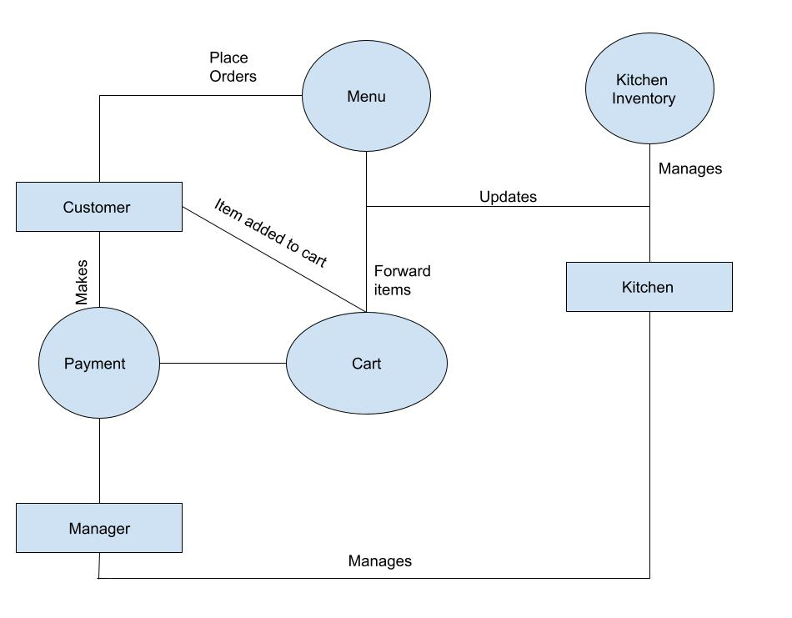
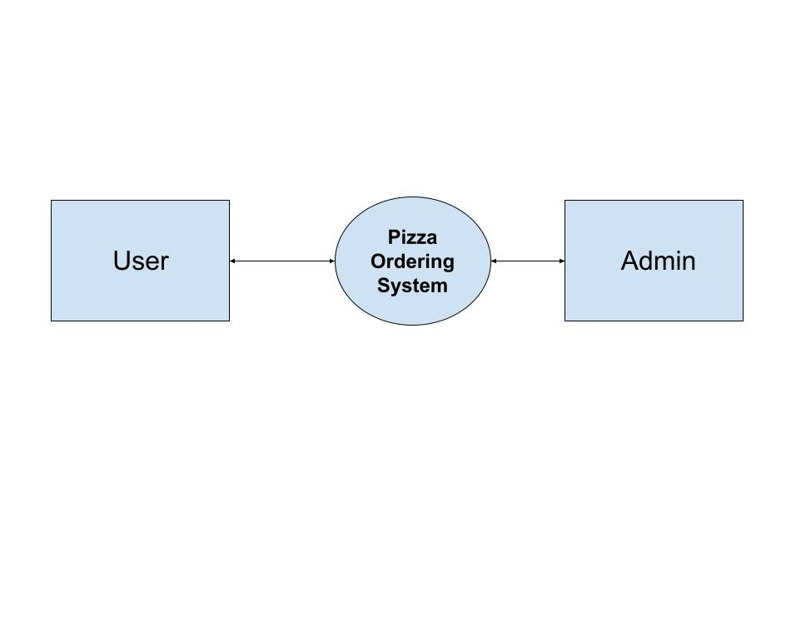
DFD
2.Level 1
1.Level 0

Slide 6
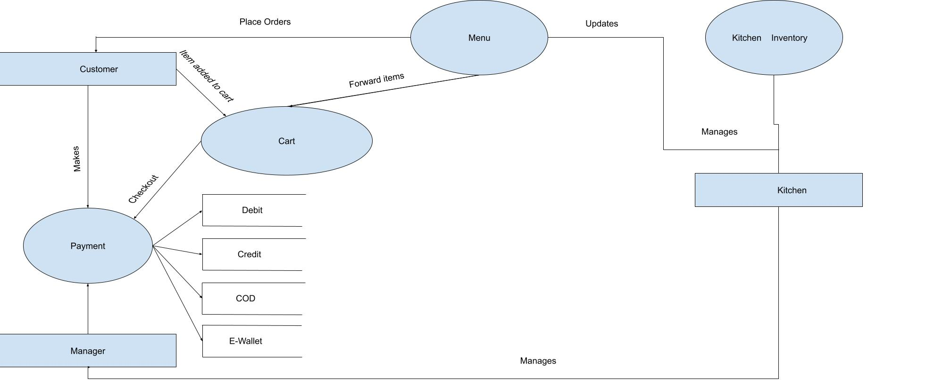
3.Level 2

Slide 7
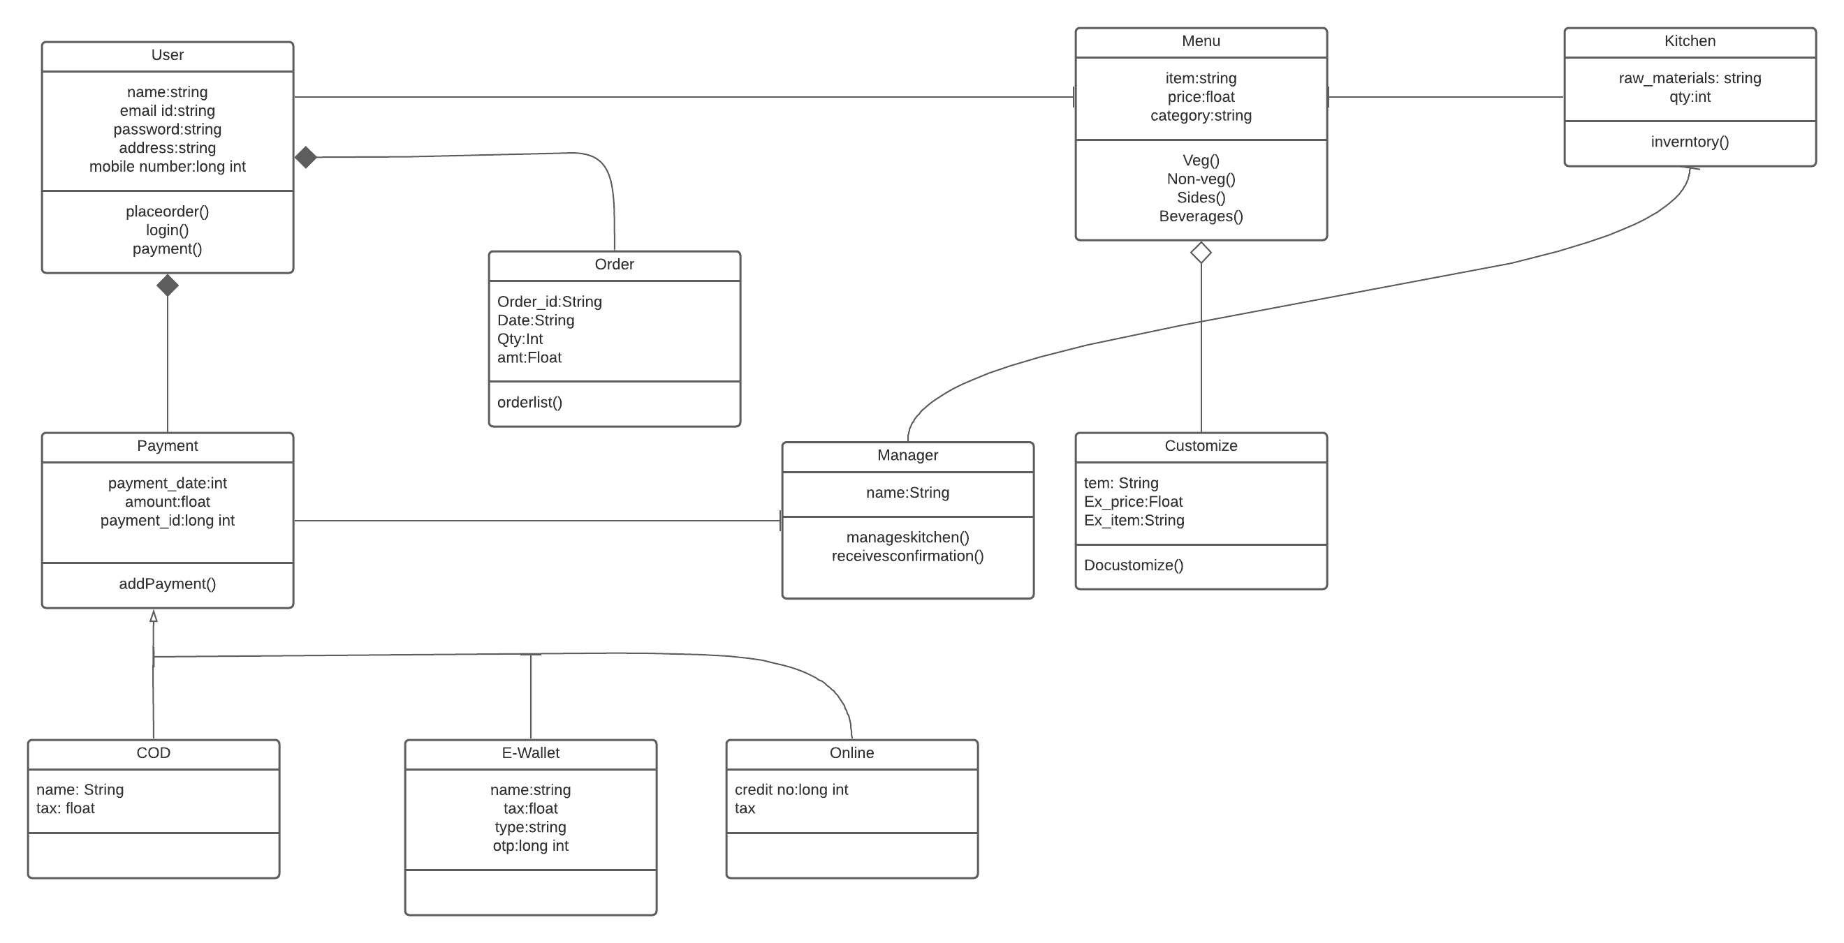
CLASS DIAGRAM

Slide 8
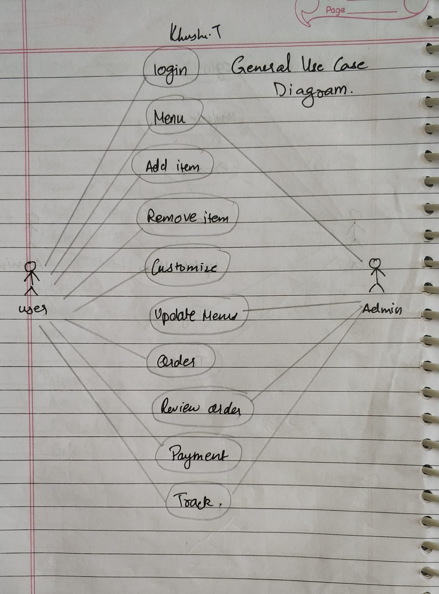
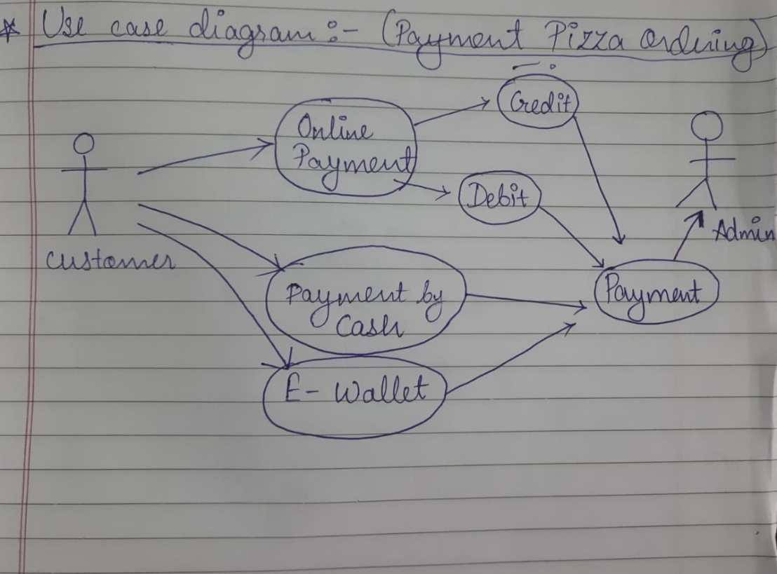
USE CASE DIAGRAMS

Slide 9
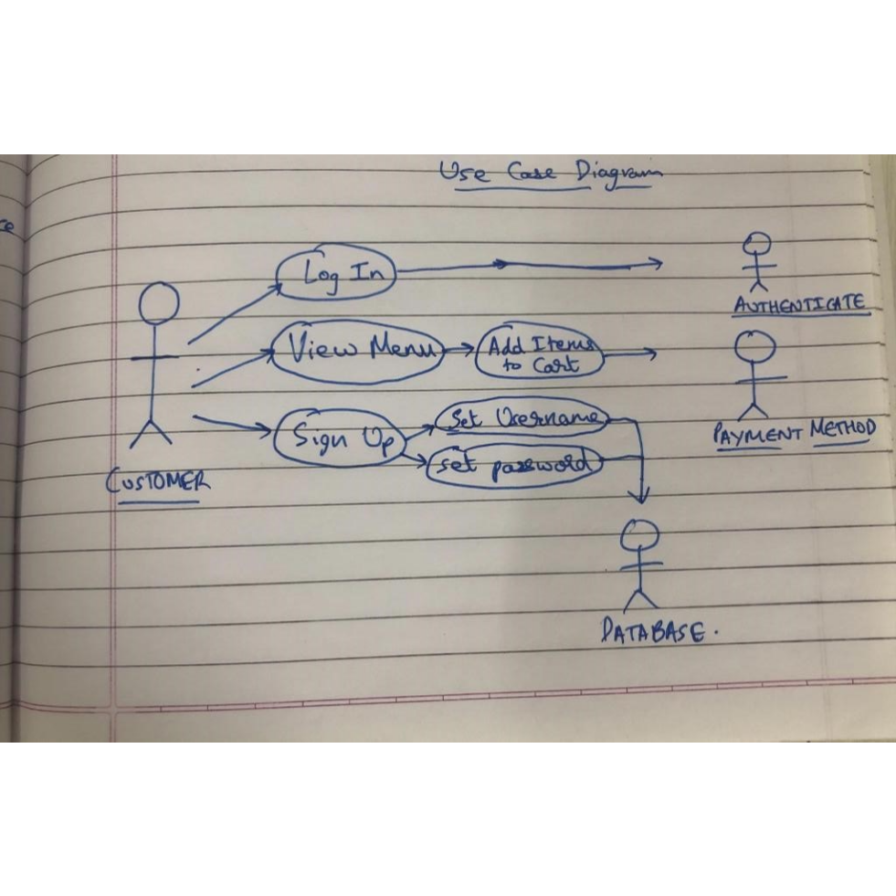
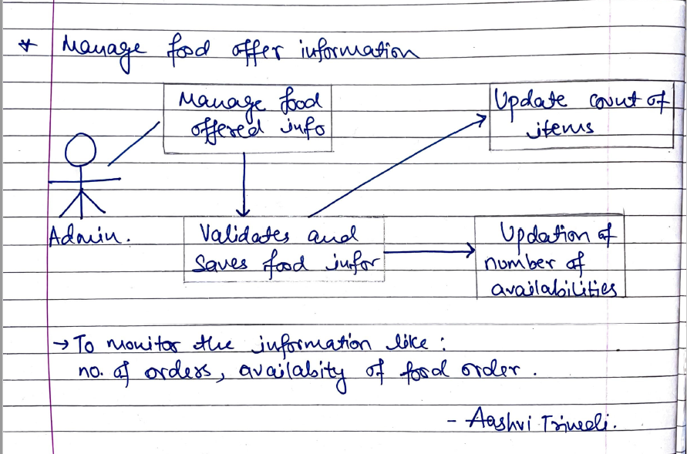
USE CASE DIAGRAMS

Slide 10
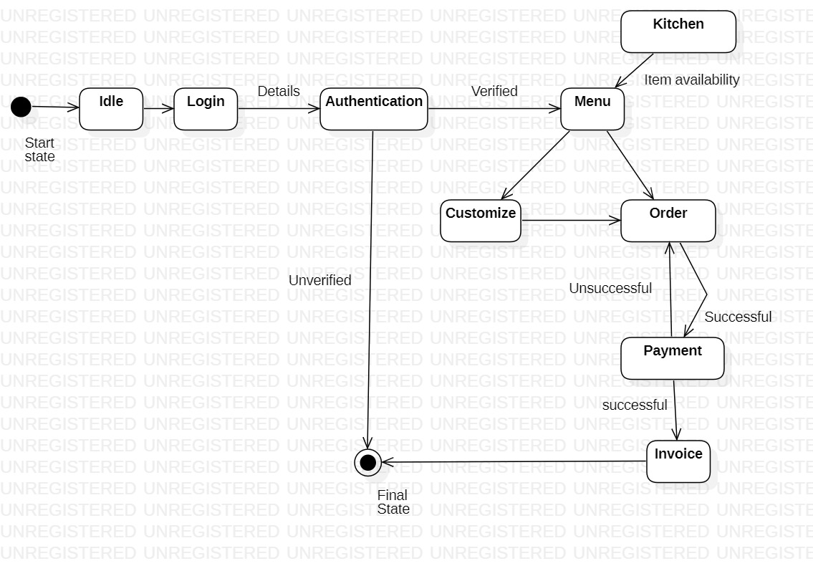
STATE CHART DIAGRAM

Slide 11
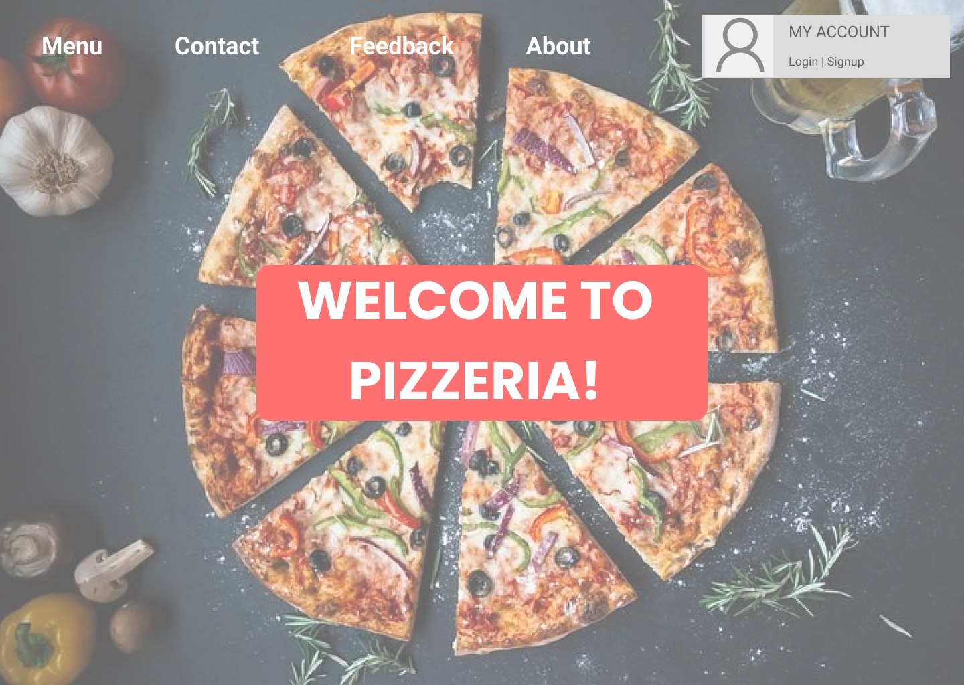
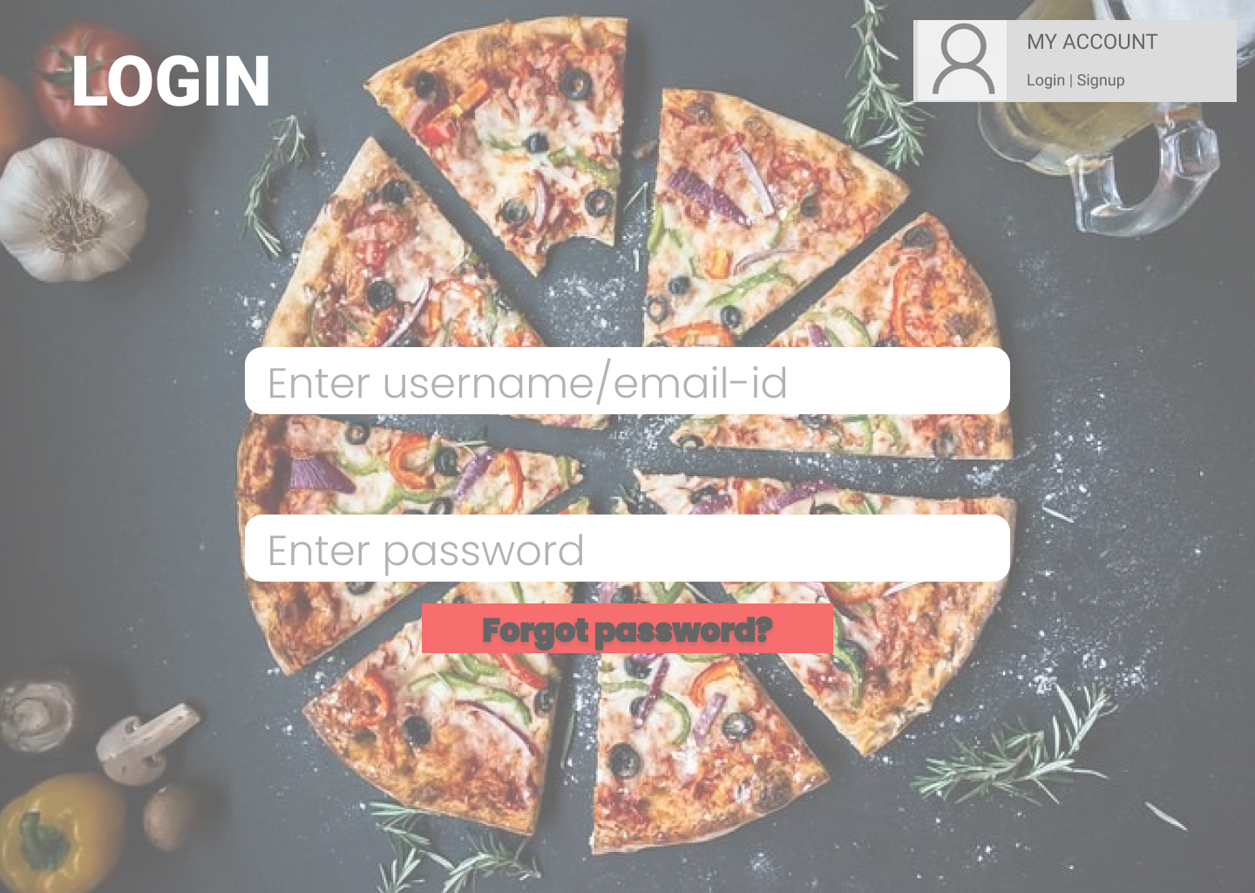
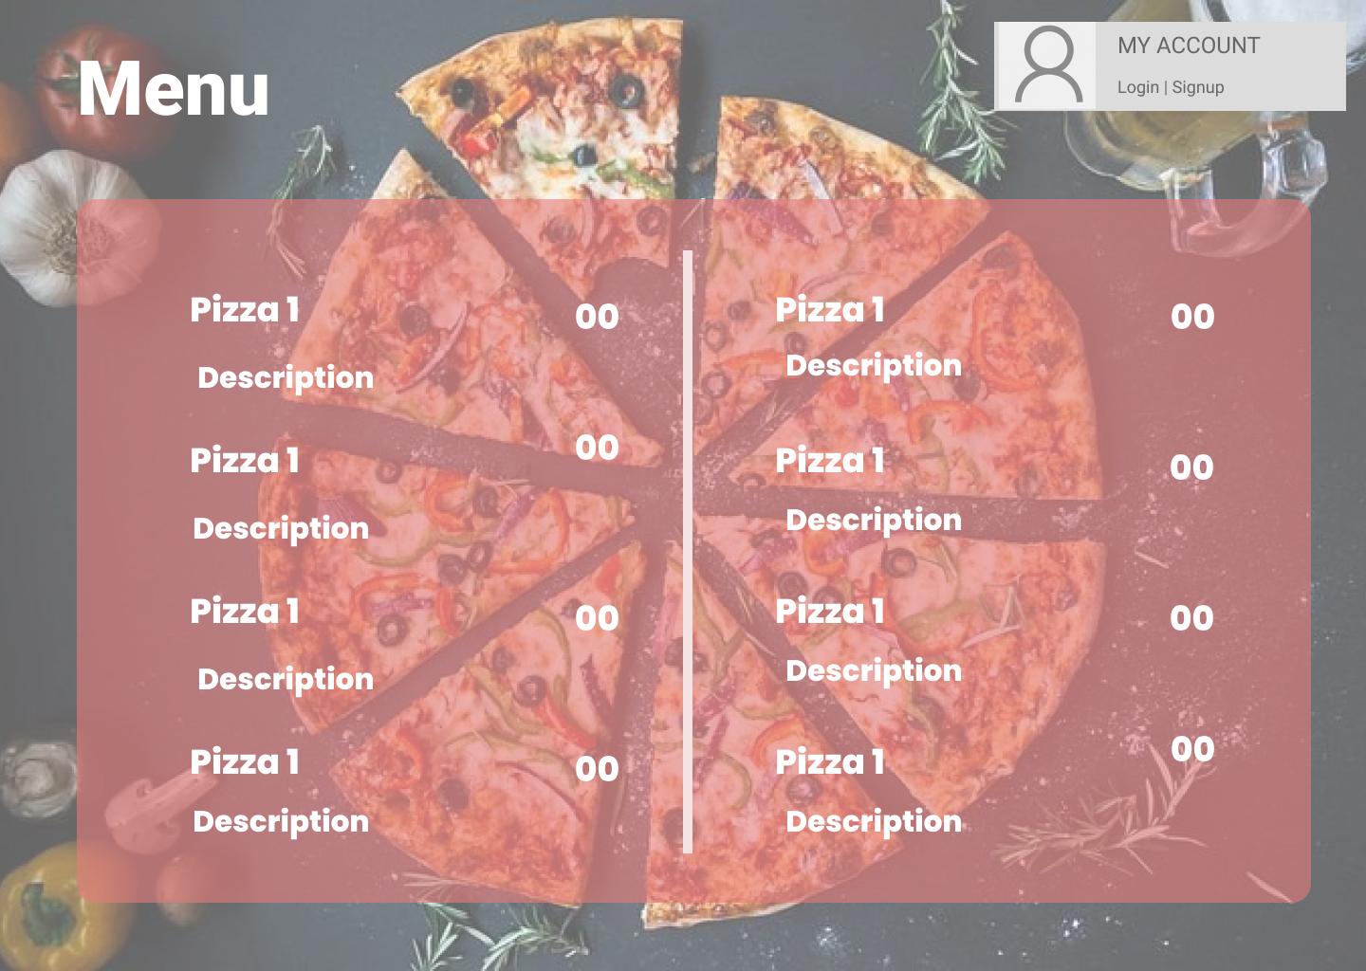
Interface
Welcome screen
Login screen
menu

Slide 12
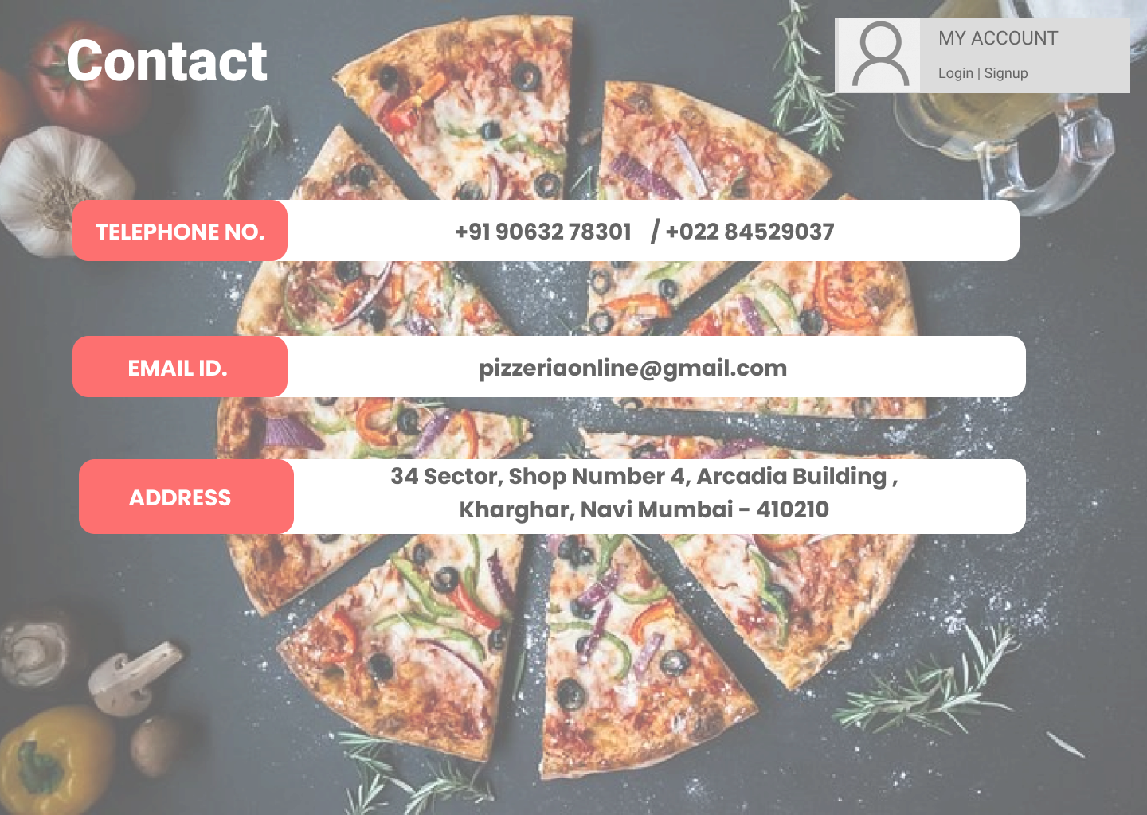
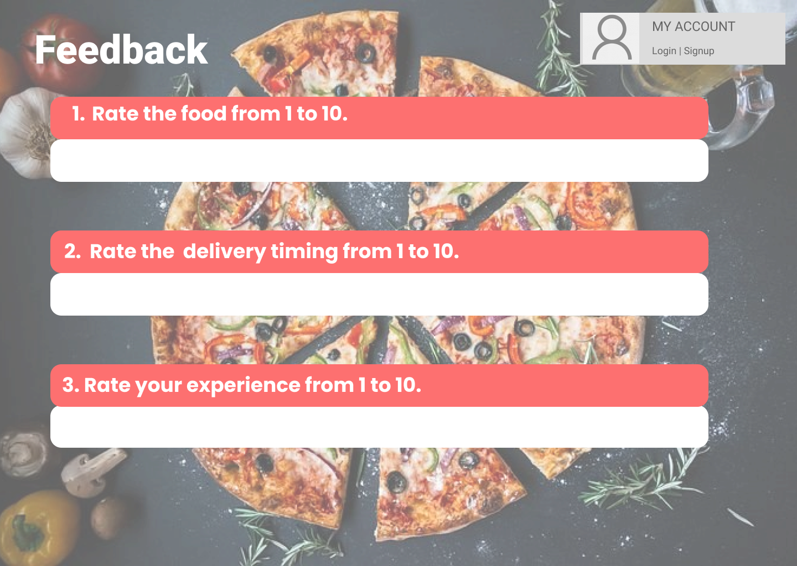
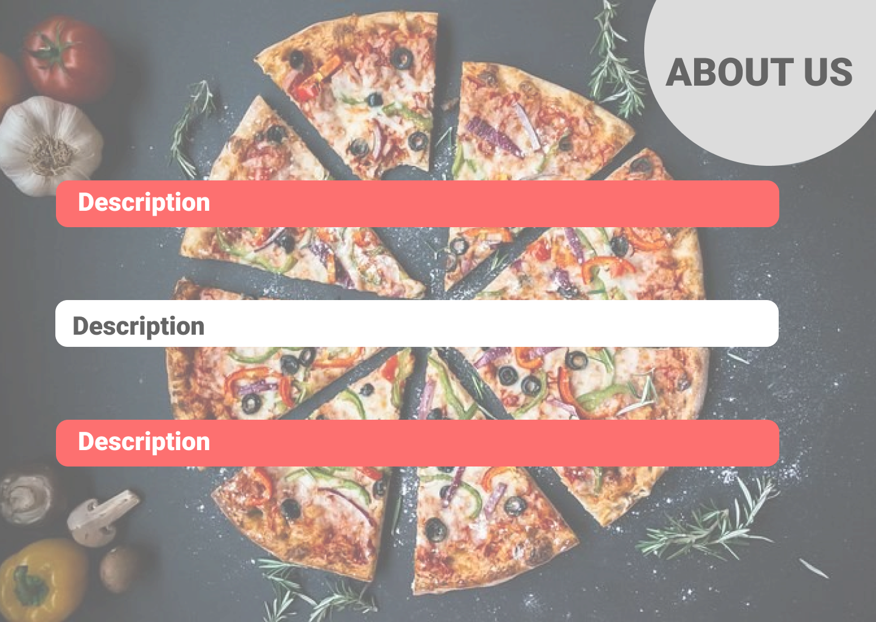
Interface
Contact details
Feedback form
About us page

Slide 13
Testing
White Box Testing:
Here, close examination of the logical parts through the software are tested by cases that exercise species sets of conditions or loops. Logical parts of the software checked once.
The box testing tests all the independent part within a module a logical decision on their true and the false side are exercised, all loops and bounds within their operational bounds were exercised and internal data structure to ensure their validity were exercised once.

Slide 14
Testing
Black Box Testing:
This enables the software engineer to device sets of input techniques that fully exercise all functional requirements for a program.
Black box testing tests the input, the output and the external data. It checks whether the input data is correct and whether we are getting the desired output.

Slide 15
3. Validation Testing:
The process of evaluating software during the development process or at the end of the development process to determine whether it satisfies specified functional and performance requirements.
4. Unit Testing:
Unit Testing is a software testing technique by means of which individual units of software are tested to determine whether they are suitable for use or not. It is correlated with functional correctness of the independent modules.
Unit Testing of software product is carried out during the development phase of a software application.

Slide 16
5.System Testing:
It is executing programs to check logical changes made in it with the intention of finding errors.
A system is tested for online response, volume of transactions, recovery from failure etc. Testing is done to ensure that system satisfies all the user requirements.
It tests the design and behavior of the system as well as the expectations of the customer.
The types are:- Performance testing, Load testing, Stress testing, Scalability testing.

Slide 17
6.Integration Testing:
It is the process of testing the interface between two software units and focuses on determining the correctness of the interface.
Integration testing aims at constructing the program structure while at the same time constructing tests to uncover errors associated with interfacing the modules.
modules are integrated by using the top-down approach.

Slide 18
FUTURE SCOPE
The following section describes the work that will be implemented with future releases of the software.
• Enhance User Interface by adding more user interactive features. Provide Deals and promotional offer details to home page. Provide Recipes of the Week/Day to Home Page.
• Allow to process an order as a Guest.
• Delivery Options: Add delivery option.
• Order Process Estimate: Provide customer a visual graphical order status bar.

Slide 19
FUTURE SCOPE
Order Status: Show only Active orders to Restaurant Employees.
Order Ready notification: Send an Order Ready notification to the customer.
Integrate with In store touch screen devices like iPad.

Slide 20
CONCLUSION
Our project satisfies the idea of imparting the knowledge of engineering approach to software development and project management. The concepts like software building techniques, importance of software quality & reliability, software testing, importance of analysis, design and construction.
Our project "Online pizza system" can lead to error free, secure, reliable and fast management system

